Slide 1
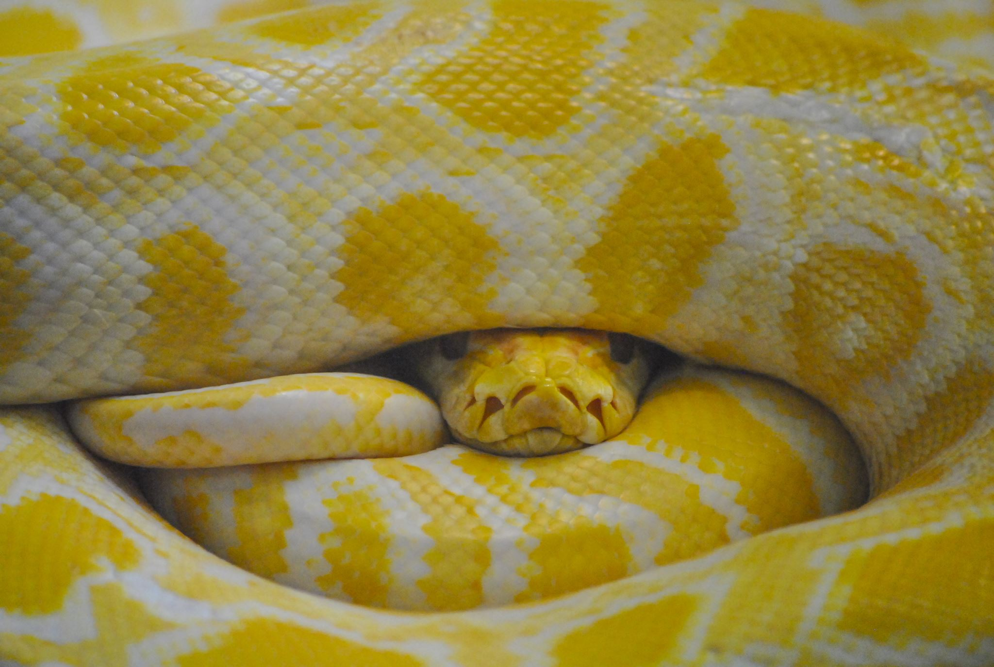
Getting Started with Python

Slide 2
What is Python?
Python is a high-level, interpreted programming language known for its simplicity, readability, and versatility.

Slide 3
Why is it considered powerful compared to other languages?
Readability: Python's syntax is designed to be clear and readable, making it easier for developers to write and maintain code.
Platform Independence: Python is cross-platform, which means Python applications can run on various operating systems.
Can do: Python can be used for web development, data analysis, artificial intelligence, machine learning, automation, game development, and more.

Slide 4
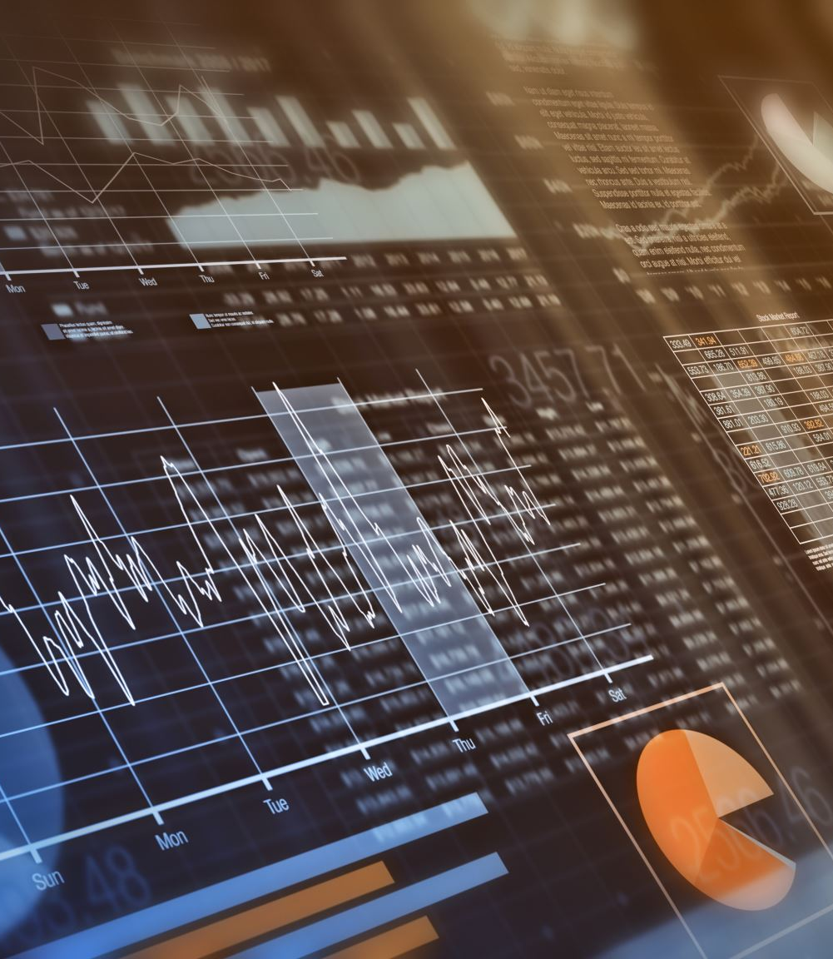
Where is it used?
Web Development: Frameworks like Django and Flask.
Data Analysis & Visualization:
Machine Learning/AI:
And more

Slide 5
Basic Syntax of Python:
Variables: Python uses dynamic typing.
x = 5
y = "Hello, World!“
How python knows the data type of x?
The interpreter knows that a is an integer because of the value 10 that's assigned to it.

Slide 6
Data types
Python is a dynamically typed language. This means that the Python interpreter infers the type of a variable at runtime based on the value assigned to it, without the need for explicit type declaration
Variables in C.
int a = 10;
But in Python,
message = "Hello, World!"
The interpreter knows message is a string because of the "Hello, World!" value.

